Slide 1


Samet Akdag
06.10.2024

Slide 2

Outline
Executive Summary
Introduction
Methodology
Results
Conclusion
Appendix

Slide 3
Executive Summary
The project focused on predicting whether the first stage of SpaceX’s Falcon 9 rockets would successfully land. Data collection was conducted using the SpaceX API and web scraping techniques, followed by data analysis using various machine learning algorithms. The prediction models achieved an accuracy rate of 83.3%.
The models predicted the success rate of first-stage rocket landings with 83.3% accuracy. These predictions enable SpaceY to present more strategic offers against SpaceX, providing a competitive advantage in the commercial space industry.

Slide 4
Introduction
SpaceY is a rapidly growing startup in the commercial space travel industry. It aims to compete with SpaceX’s Falcon 9 rockets. SpaceX provides a cost advantage with its reusable rocket technology. The goal of the project is to develop a prediction model that can help SpaceY make more strategic decisions in this field.
The main question this project seeks to answer is how to predict whether SpaceX will successfully recover the first stage of a rocket. This prediction is crucial for understanding launch costs and gaining an advantage in competing bids.

Slide 5

Section 1

Slide 6
Methodology
Executive Summary
Data Collection: The data collection process was carried out using Python to gather data related to SpaceX's Falcon 9 launches. Data was collected using API and web scraping techniques.
Data Wrangling: The collected data was cleaned, and missing values were handled appropriately.
Data Processing: The data was processed using Python libraries and made suitable for analysis.
EDA Using Visualization and SQL: Exploratory data analysis was performed on the data, and the data was visualized using Matplotlib, Seaborn, and SQL.
Interactive Visual Analytics: Folium was used for maps, and Plotly Dash was used for interactive charts. The map analysis shows launch sites and successful landing rates.
Predictive Analysis: Classification models such as Logistic Regression, SVM, Decision Tree, and KNN were trained, and hyperparameter tuning was performed. The models were tested with an accuracy of 83.3%.

Slide 7
Data Collection
Data Request (GET request)
Data Filtering
Handling Missing Values
Conversion to Pandas DataFrame
Data Sources: Data was collected using web scraping techniques from the SpaceX API and Wikipedia. The data from these two sources contains historical information about Falcon 9 rocket launches.
Using SpaceX API: Data on Falcon 9 rockets was retrieved from the SpaceX API using a GET request. The data obtained from the API was filtered specifically to analyze landing successes.
Web Scraping: Additional information regarding Falcon 9 and Falcon Heavy launches was gathered from the Wikipedia page. The HTML table structure was parsed, and the data was converted into a pandas dataframe.
Missing Values: Missing data was filled with the average value of the respective column to ensure data integrity.

Slide 8
Data Collection – SpaceX API
Using REST API: Raw data on rocket launches was obtained using SpaceX's publicly available REST API. These API calls returned data in JSON format.
GET Request: Information about Falcon 9 launches was collected through a GET request to the SpaceX API.
Filtering: Only Falcon 9 launches were selected to create the relevant dataset.
Missing Values: Missing values in the launch data were filled with the mean, and the data was cleaned prior to analysis.
GitHub URL: https://github.com/AKDG-SMT/Data-Collection-API-Lab.git
GET
Data Filtering
Handling Missing Values
Data in JSON Format
Converting to Pandas DataFrame

Slide 9
Data Collection - Scraping
GET Request (Wikipedia)
Table Identification
Data Transformation into Pandas DataFrame
HTML Parsing (BeautifulSoup)
Web Scraping Process: Data related to the Falcon 9 and Falcon Heavy launch list on Wikipedia was scraped using Python’s Requests and BeautifulSoup libraries.
Request to Wikipedia: A request was sent to the relevant Wikipedia page.
HTML Parsing: The Wikipedia page was retrieved in HTML format and parsed using BeautifulSoup.
Data Extraction: HTML table structures were identified, and data was extracted along with the table headers.
DataFrame Transformation: The extracted data was transformed into a pandas DataFrame, making it ready for analysis.

Slide 10
Data Wrangling
Data Processing Steps: After data collection, missing or erroneous values were handled, and the data was cleaned and organized for analysis.
Missing Value Handling: Missing data was filled with the averages of the respective columns.
Outlier Detection: Outliers were identified using outlier analysis and handled appropriately.
Data Standardization: The data was normalized for model training.
Feature Engineering: Necessary features were created, and the training set was prepared for the classification model.

Slide 11
EDA with Data Visualization
FlightNumber vs PayloadMass: A scatter plot was used to examine the relationship between flight numbers and payload mass. This helps to identify any trends in payload mass over the different launches.
FlightNumber vs LaunchSite: A bar chart was used to show the frequency of launches from different sites. This visualized launch site performance across multiple flights.
PayloadMass vs LaunchSite: A scatter plot was used to analyze how payload mass varies by launch site, giving insights into how different sites handle different payload sizes.
Orbit Type vs Success Rate: A bar chart was plotted to display the success rates of launches across different orbit types. This helped identify which orbits are more likely to have successful launches.
Yearly Success Trend: A line plot was used to show the trend of launch success rates over the years, revealing any improvements or regressions over time.
GitHub: https://github.com/AKDG-SMT/Data-Collection-API-Lab/blob/main/jupyter-labs-eda-dataviz%20(1).ipynb

Slide 12
EDA with SQL
Launch Sites Query: Retrieved data for all the launch sites used in Falcon 9 launches.
Payload Mass Query: Queried the database to get the payload mass associated with each launch.
Booster Version Query: Retrieved information about the versions of the boosters used in the launches.
Mission Outcome Query: Listed the outcomes (success or failure) of each mission.
Booster Landing Query: Displayed information on whether the booster successfully landed or not after the launch.
GitHub: https://github.com/AKDG-SMT/Data-Collection-API-Lab/blob/main/jupyter-labs-eda-sql-coursera_sqllite%20(1).ipynb

Slide 13
Build an Interactive Map with Folium
Map Objects Added
Markers: Added markers to indicate the location of each launch site. These markers help in identifying the geographical spread of the launch sites.
Colored Circles: Different colored circles were added around the markers to represent the success rate of launches from each site, giving a quick visual indication of the performance.
Lines: Lines were used to display proximity to important infrastructure such as highways, railways, and coastlines. This was done to analyze how these factors may impact the choice of launch sites and their success rates.
Why Added
Markers: To clearly identify the exact geographic locations of all launch sites.
Colored Circles: To visually distinguish between successful and failed launches at a glance.
Lines: To assess the strategic advantages of each launch site based on proximity to infrastructure, which might influence operational efficiency.
GitHub: https://github.com/AKDG-SMT/Data-Collection-API-Lab/blob/main/lab-jupyter-launch-site-location-v2%20(1).ipynb

Slide 14
Build a Dashboard with Plotly Dash
Plots/Graphs Added
Pie Chart: A pie chart was included to display the success rates of launches by launch site, color-coded for clarity.
Scatter Plot: A scatter plot was added to show the relationship between payload mass and landing outcomes, helping to visualize which payloads were more likely to result in a successful landing.
Range Slider: A range slider was used to filter payload mass dynamically. Users could adjust the range to view data specific to payload masses they are interested in.
Dropdown Menu: A dropdown was added to allow users to select individual launch sites or view data for all sites simultaneously.

Slide 15
Build a Dashboard with Plotly Dash
Why Added:
Pie Chart: To give a clear overview of the success distribution across different launch sites, helping stakeholders quickly assess which sites perform better.
Scatter Plot: To visualize how payload mass affects the likelihood of a successful booster landing, providing insights into optimal payload conditions.
Range Slider: To make the dashboard interactive, allowing users to filter data based on payload mass ranges, making it easier to explore specific subsets of data.
Dropdown Menu: To offer flexibility in analyzing data either globally across all launch sites or at a specific site level, catering to different stakeholder needs.

Slide 16
Predictive Analysis (Classification)
Model Building: Several classification models were built, including:
Logistic Regression
Support Vector Machine (SVM)
Decision Tree Classifier
K Nearest Neighbors (KNN)
Data Preparation:The dataset was split into training and test sets.
Feature engineering was conducted, including creating a "Class" column representing the first-stage booster landing outcome.
Data was standardized to ensure all features contributed equally.

Slide 17
Predictive Analysis (Classification)
Model Evaluation:
Accuracy scores were calculated for each model using the test data. Confusion matrices were generated to identify misclassifications.
The models were evaluated based on accuracy and the confusion matrix results, highlighting false positives and negatives.
Model Improvement:
Hyperparameter tuning was performed using GridSearchCV to find the best parameter combinations for each model.
Best Model:
After tuning, the Logistic Regression model achieved the highest accuracy and was selected as the best-performing model, with an accuracy of 83.33%.
GitHub: https://github.com/AKDG-SMT/Data-Collection-API-Lab/blob/main/SpaceX-Machine-Learning-Prediction-Part-5-v1%20(1).ipynb

Slide 18
Results
Visualizations revealed that payload mass and orbit type are strong indicators of launch success. Certain launch sites had significantly higher success rates compared to others, such as KSC LC-39A.
The final Logistic Regression model achieved an accuracy of 83.33% in predicting the success of a first-stage booster landing. Confusion matrix analysis revealed some false positives, but the model provided valuable predictive insights for SpaceY’s competitive strategy against SpaceX.

Slide 19

Section 2

Slide 20
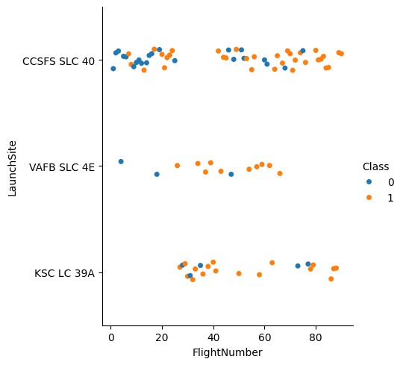
Results – EDA: Visualize the relationship between Flight Number and Launch Site
Insight: VAFB SLC 4E and KSC LC 39A Launch Sites have high success rates

Slide 21
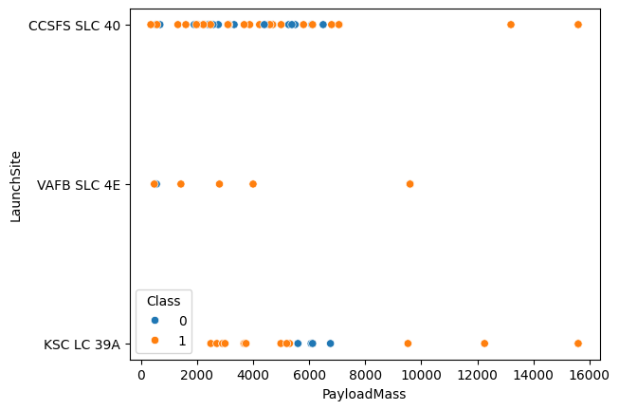
Results – EDA:
Visualize the relationship between Payload and Launch Site
Insight: Very high success rate when Payload Mass is between [2000,5000]. Payload Mass above 8000 also has high success rate, but low statistical significance.

Slide 22
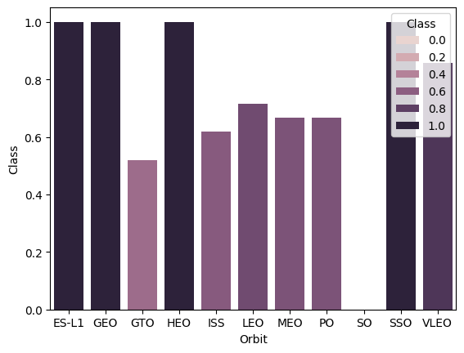
Results – EDA:
Visualize the relationship between success rate of each orbit type
Insight: ES-L1, GEO, HEO, SSO, VLEO Orbits has high success rate. But this has not considered statistical significance.

Slide 23
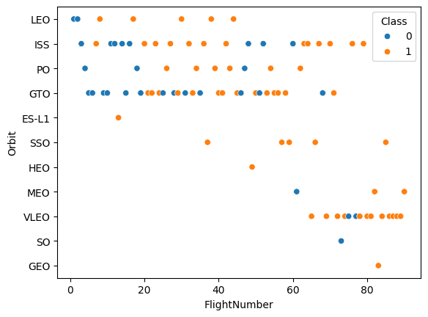
Results – EDA:
Visualize the relationship between Flight Number and Orbit type
Insight: LEO Orbit option has improved success rate over time.

Slide 24
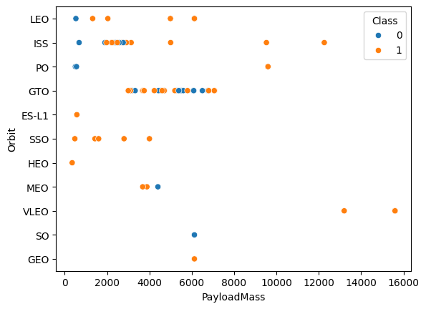
Results – EDA:
Visualize the relationship between Payload and Orbit type
Insight: In the case of heavy payloads, the successful landing or positive landing rate is more favourable for PO, LEO and ISS. However, for GTO, it is not possible to distinguish between the positive landing rate and the negative landing (unsuccessful mission) with the same degree of clarity.

Slide 25
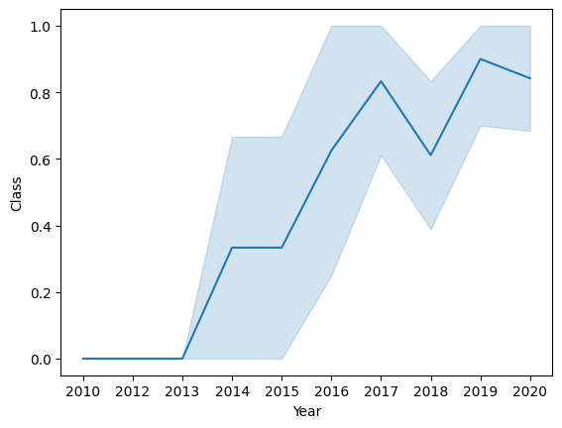
Results – EDA:
Visualize the launch success yearly trend
Insight: The success rate since 2013 kept increasing till 2017 (stable in 2014) and after 2015 it started increasing.

Slide 26
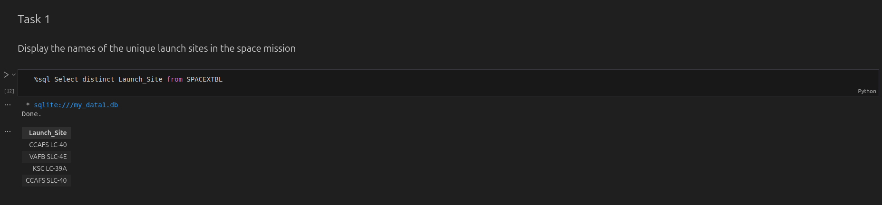
All Launch Site Names

Slide 27
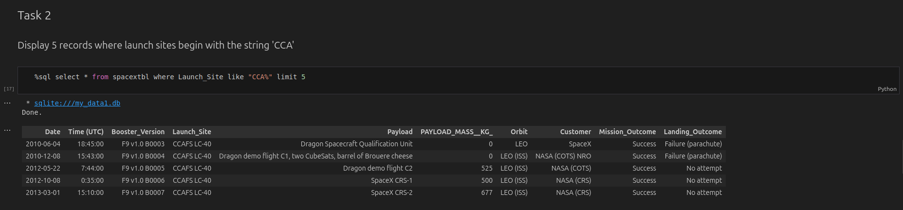
Launch Site Names Begin with 'CCA'

Slide 28
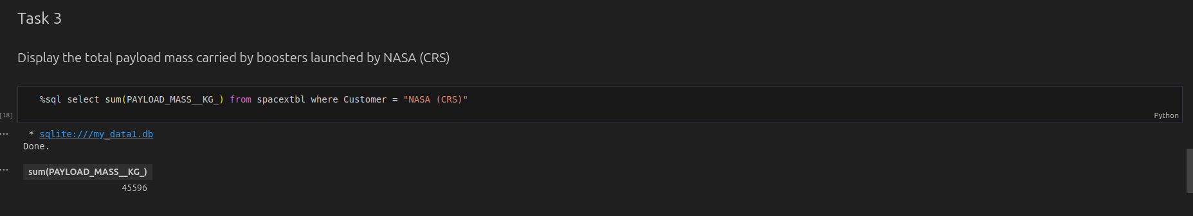
Total Payload Mass

Slide 29
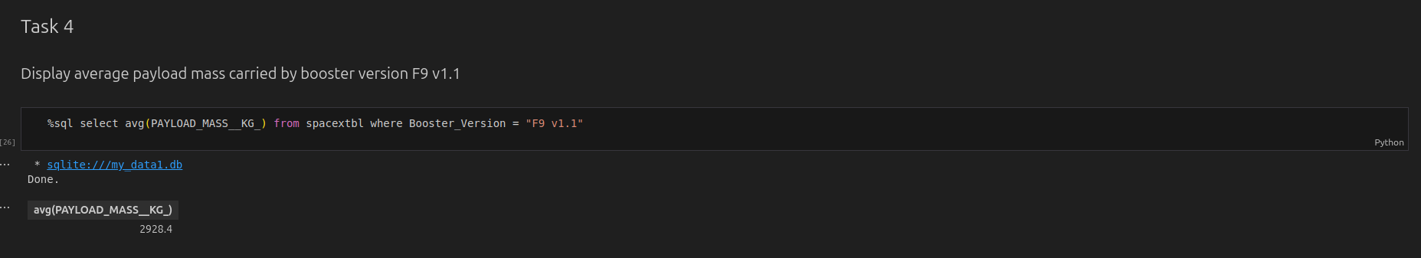
Average Payload Mass by F9 v1.1

Slide 30
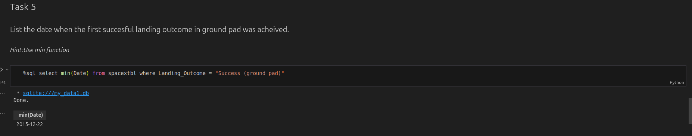
First Successful Ground Landing Date

Slide 31
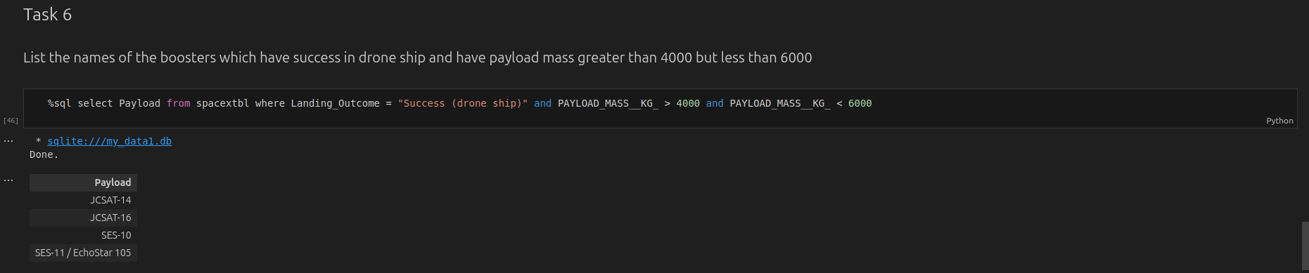
Successful Drone Ship Landing with Payload between 4000 and 6000

Slide 32
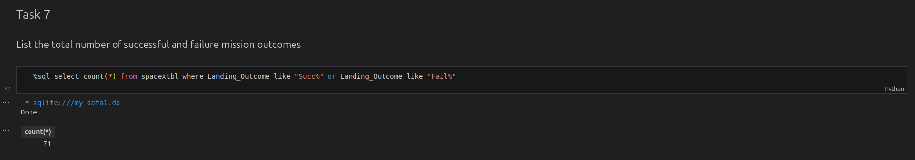
Total Number of Successful and Failure Mission Outcomes

Slide 33
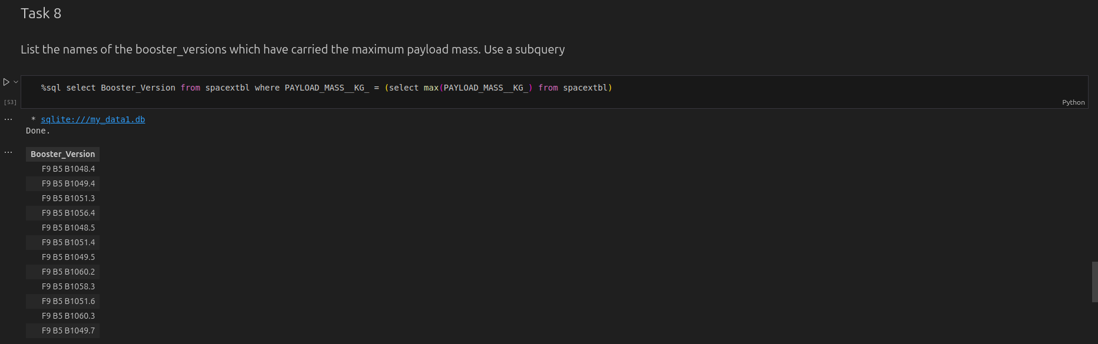
Boosters Carried Maximum Payload

Slide 34
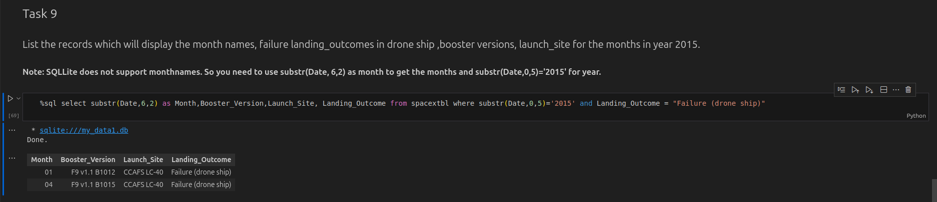
2015 Launch Records

Slide 35
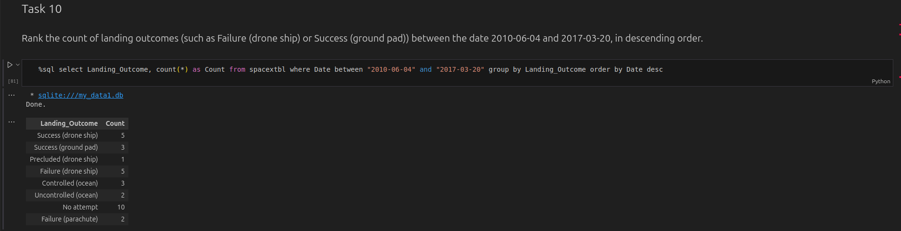
Rank Landing Outcomes Between 2010-06-04 and 2017-03-20

Slide 36

Section 3

Slide 37
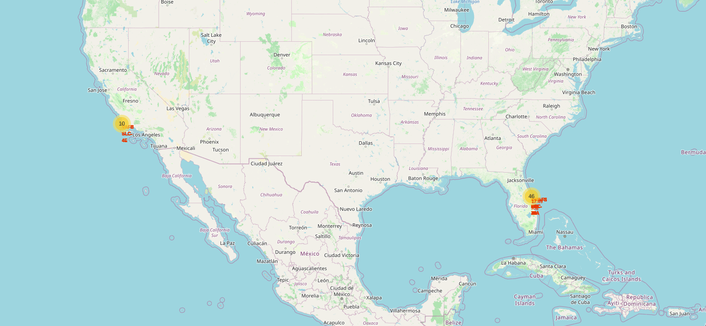
Result – Folium Map: All launch sites

Slide 38
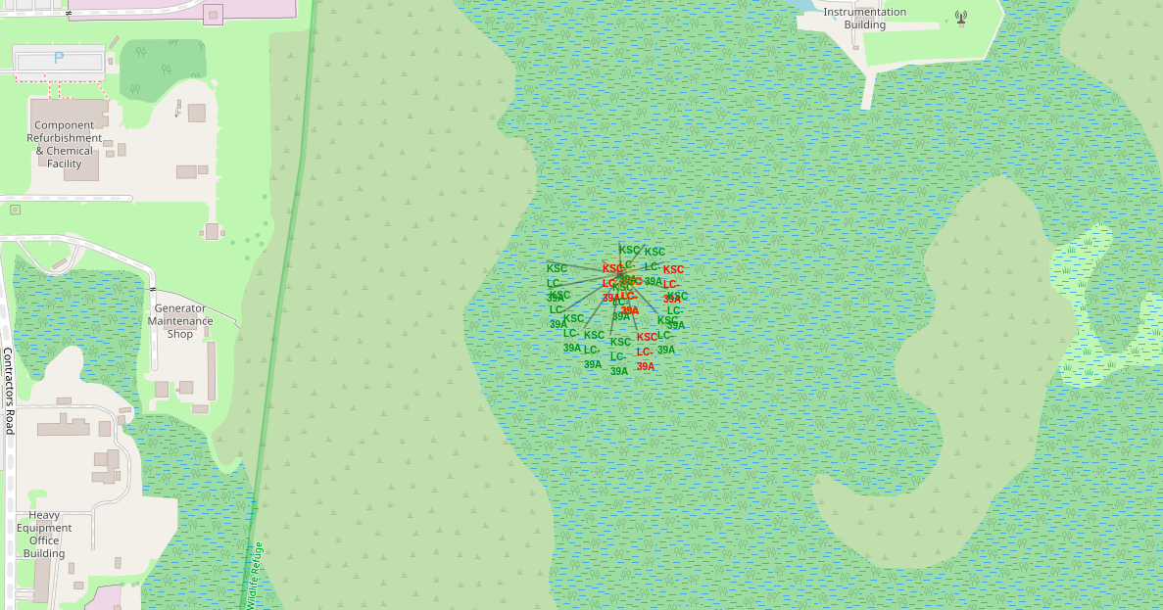
Result – Folium Map: Launch Outcomes

Slide 39
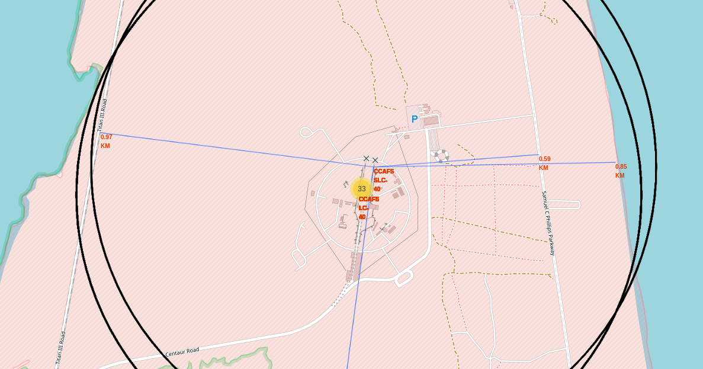
Result – Folium Map: Distance from proximities
Distance from nearest railway: 0.97KM.
Distance from nearest highway: 0.59KM.
Distance from nearest coastline: 0.85 KM.

Slide 40
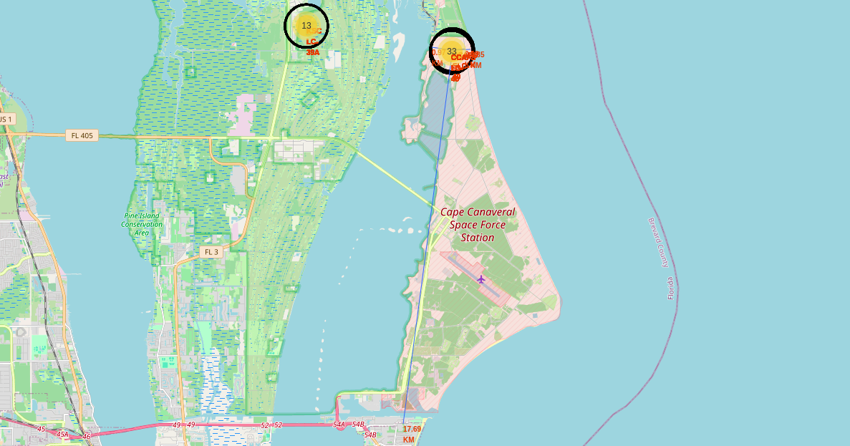
Result – Folium Map: Distance from proximities
Distance from nearest city: 17.69 KM.

Slide 41

Section 4

Slide 42
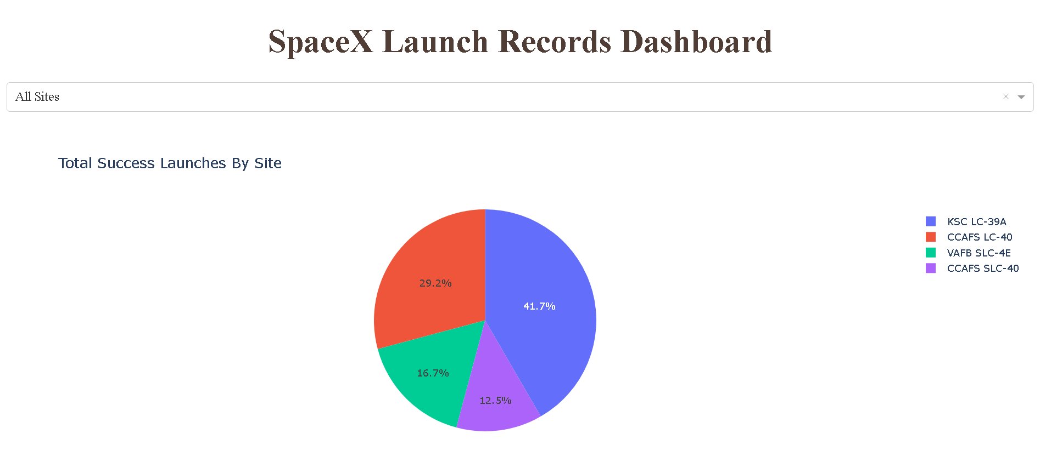
Results – Interactive: Pie Chart

Slide 43
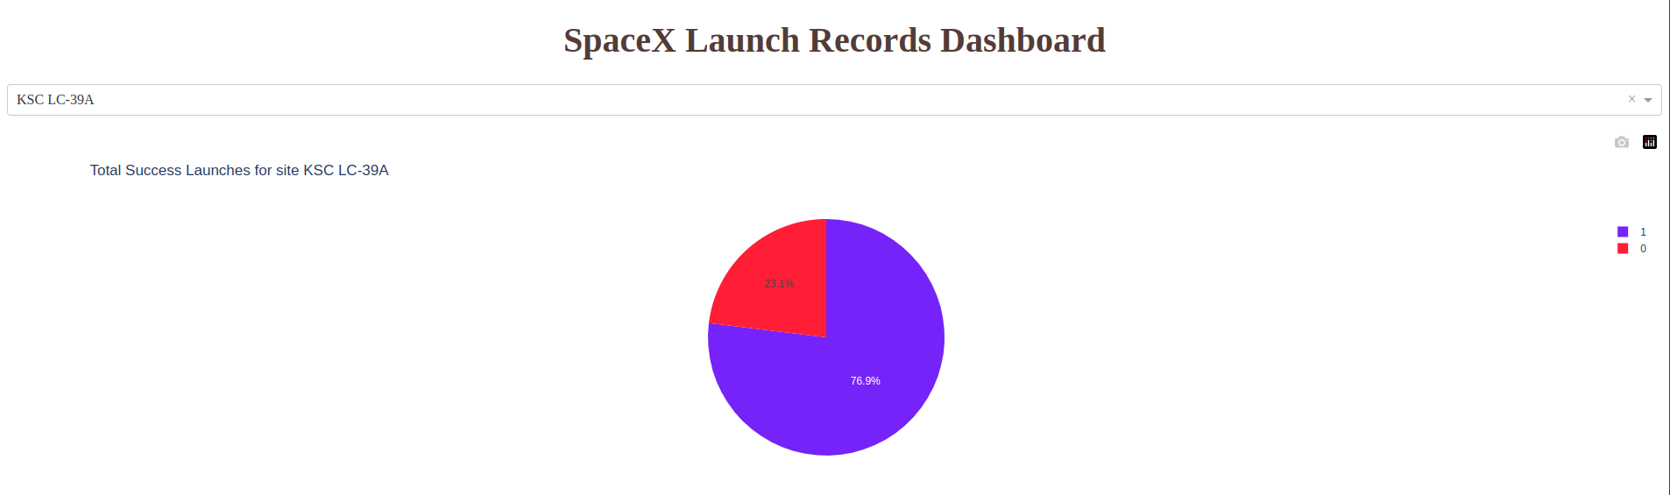
Results – Interactive: Highest success rate site pie chart

Slide 44
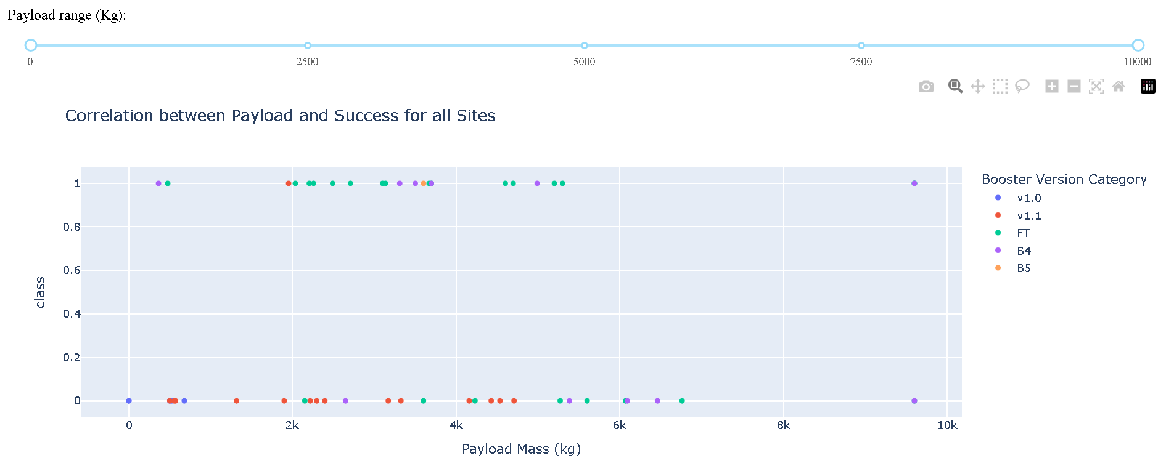
Results – Interactive: Slider & Scatter Plot

Slide 45

Section 5

Slide 46
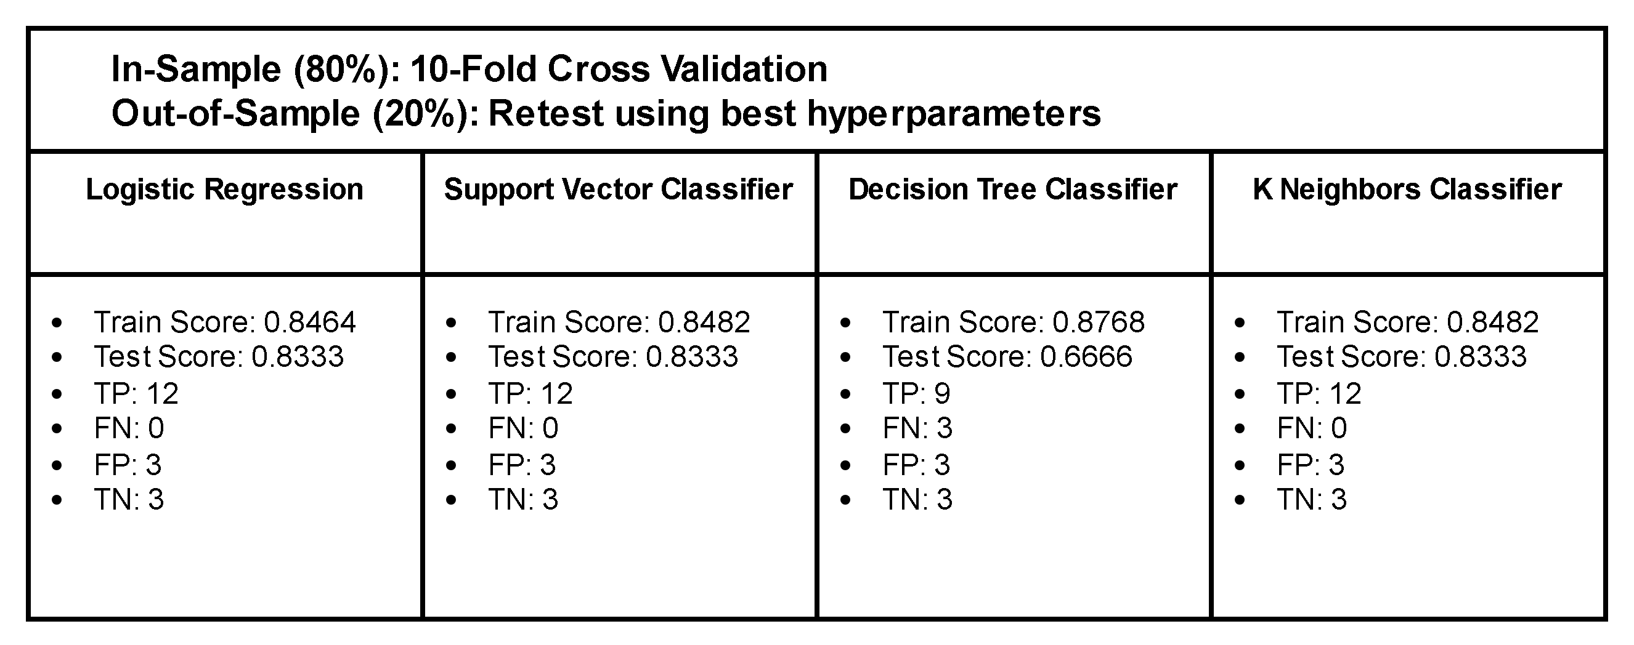
Results – Predictive Analysis

Slide 47
Conclusions
Launch Success: The probability of success is contingent upon the specific launch site and the optimal payload range, which is defined as 2,000 to 5,000 kilograms.
Orbit Types: It can be observed that specific orbital paths, such as ES-L1 and GEO, demonstrate a higher degree of success.
Predictive Analysis: Three out of four machine learning models have been demonstrated to effectively predict SpaceX's first stage reuse, thereby illustrating the potential value of such forecasting techniques.
The insights gained from this analysis can assist SpaceY in optimising its launch strategies, with a particular focus on identifying more successful launch sites and payload configurations. By employing analogous machine learning models, SpaceY could enhance its predictive capabilities, thereby optimising decision-making and operational efficiency.

Slide 48
Appendix
The Decision Tree Classifier produces disparate scores when the Jupyter notebook is executed anew.
In addition to the Decision Tree Classifier, all other models are equally suitable for predicting landing success with a test precision of 0.8333.

Slide 49


